Slide 1
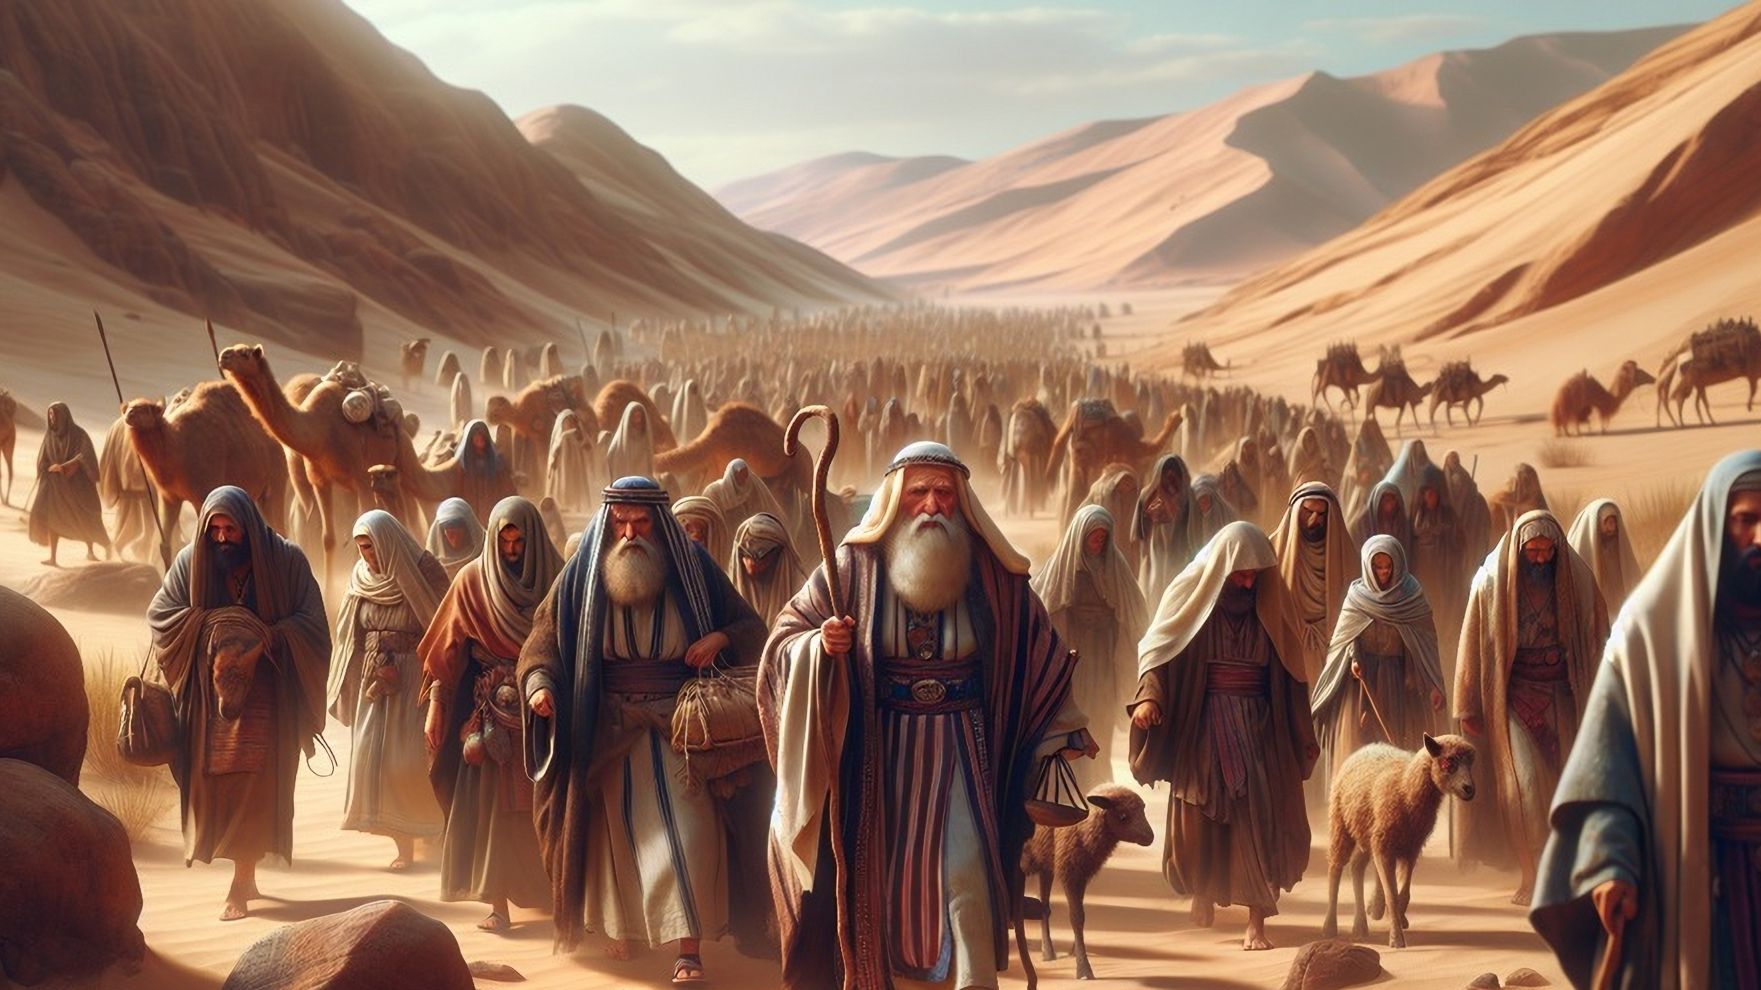
Out of Egypt,
But is Egypt OUT OF ME?

Slide 2

EXODUS 2 : 11 - 15
. . . Moses did as Pharaoh. . .

Slide 3
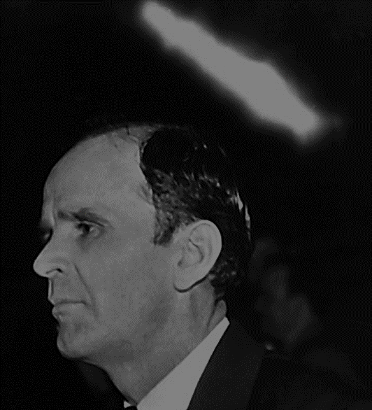
64-0719E Going Beyond The Camp
What was it? He, now, the people thought he was crazy. But what had he done? Got out of his own camp. Pharaoh educated him forty years in the school camp, and he failed. And it taken God another forty years to get it out of him. All of his education and all of his theology that he had been taught, it taken forty years to get it out of him. And then God used him a forty years.

Slide 4
64-0719E Going Beyond The Camp
God has an awful time preparing His man. But, you see, He never could ahold of Moses, till Moses got out of his own man-made camp, from the military way of doing it, and the natural way of doing it, unto the supernatural way of doing it. Then, when he got in that camp, God could use him.

Slide 5
64-0409 The Identification Of Christ In All Ages
But when Moses was called, took forty years of schooling, then forty years to get it all out of him again, then God called him by the supernatural Light, a Pillar of Fire laying back in a burning bush. And he knowed more about God, in five minutes, than he learned in forty years, because he was in His Presence.

Slide 6
NUMBERS 11 : 1 - 6
. . . but Egypt! . . .

Slide 7
59-0810 The Reaction To An Action
And I want to say this: that God will never hear your prayer as long as you hide iniquity in your heart, He will not do it. ...

Slide 8
God settles the matter!

Slide 9
II CORINTHIANS 12 : 7 – 10
. . . No Egypt found in Paul, now to be proven! . . .

Slide 10
Out of Egypt,
But is Egypt OUT OF ME?

